Slide 1
The Unconscious Patient

Slide 2
The Unconscious Patient

Slide 3
The Unconscious Patient
definitions
causes
assessment
management

Slide 4
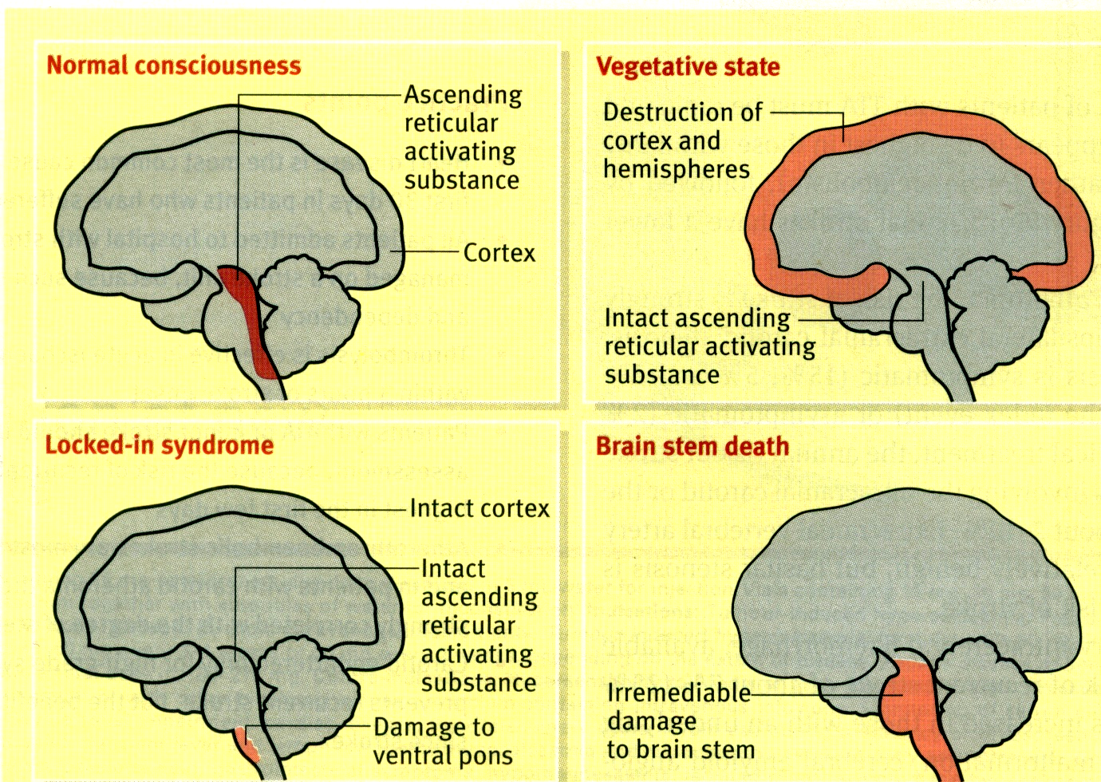

Slide 5
Definitions
consciousness
sleep
drowsiness, stupor, coma
confusion
delirium

Slide 6
consciousness
  awareness of self and environment
  ability to respond to stimuli
sleep
  arousal → aware, can respond
stupor
  respond only to vigorous stimuli
coma
  unrousable unresponsiveness
confusion
  impaired consciousness, attention, orientation, memory
delirium
  acute confusion with psychomotor overactivity

Slide 7
Level of consciousness
assessment by Glasgow Coma Scale
  eye opening
  best verbal response
  best motor response

Slide 8
Definitions
vegetative state
locked-in syndrome
brain stem death

Slide 10
Altered consciousness

Slide 11
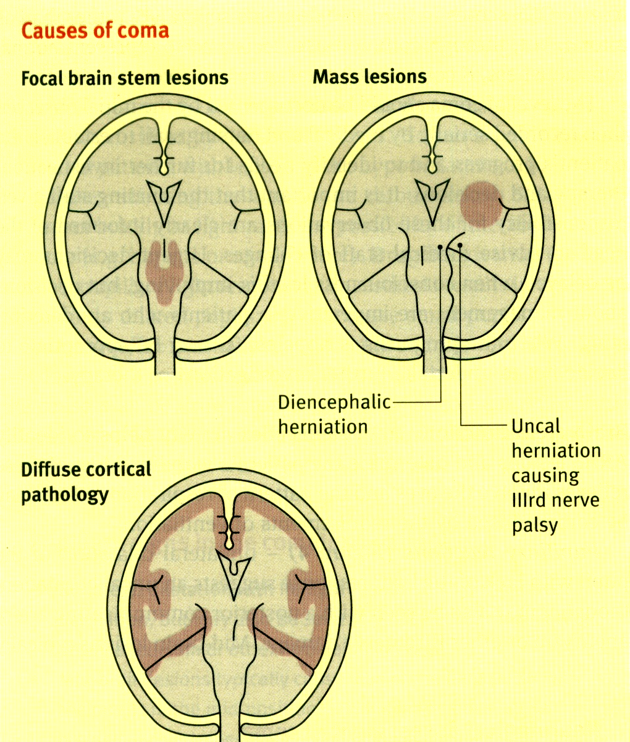
altered consciousness - mechanisms
diffuse cortical dysfunction
  intracranial, extracranial
focal supratentorial lesion - ↑ ICP
brain stem / infratentorial lesion

Slide 12
altered consciousness - causes
diffuse cortical dysfunction
  intracranial - infection, vascular (SAH), trauma
  extracranial -
    metabolic - organ failure, electrolytes
    toxic - alcohol, drugs, …
    hypoxia, malignant HT
    endocrine
focal supratentorial lesion - ↑ ICP
  tumour, abscess, haematoma, infarct, trauma
brain stem / infratentorial lesion
  tumour, abscess, haematoma, infarct, trauma…..

Slide 13
altered consciousness - assessment

Slide 14
altered consciousness - assessment
GCS
brain stem function
motor function
after ABC, resuscitation

Slide 15
altered consciousness - assessment
GCS
brain stem function
  pupils - size, light reflex
  corneal reflex
  eye position, eye movements
  oculo-cephalic reflexes - ‘doll’s eye’
  vestibulo-ocular reflexes
  respiration
motor function

Slide 16
altered consciousness - assessment
GCS
brain stem function
motor function
  motor response
  tone
  reflexes
  seizures

Slide 17
altered consciousness - assessment
Pupils
  unilateral dilated, no light reflex -
  III N. damage, uncal herniation
  bilateral mid-position, no light reflex -
  midbrain lesion
  bilateral pinpoint pupils -
  pontine lesions
  bilateral small, reactive -
  metabolic

Slide 18
altered consciousness - assessment
eye position, eye movements
III N palsy, VI N palsy
conjugate gaze palsy
  cortical - ‘patient looks towards the lesion’ away from paralysed side
  pontine - towards paralysed side

Slide 19
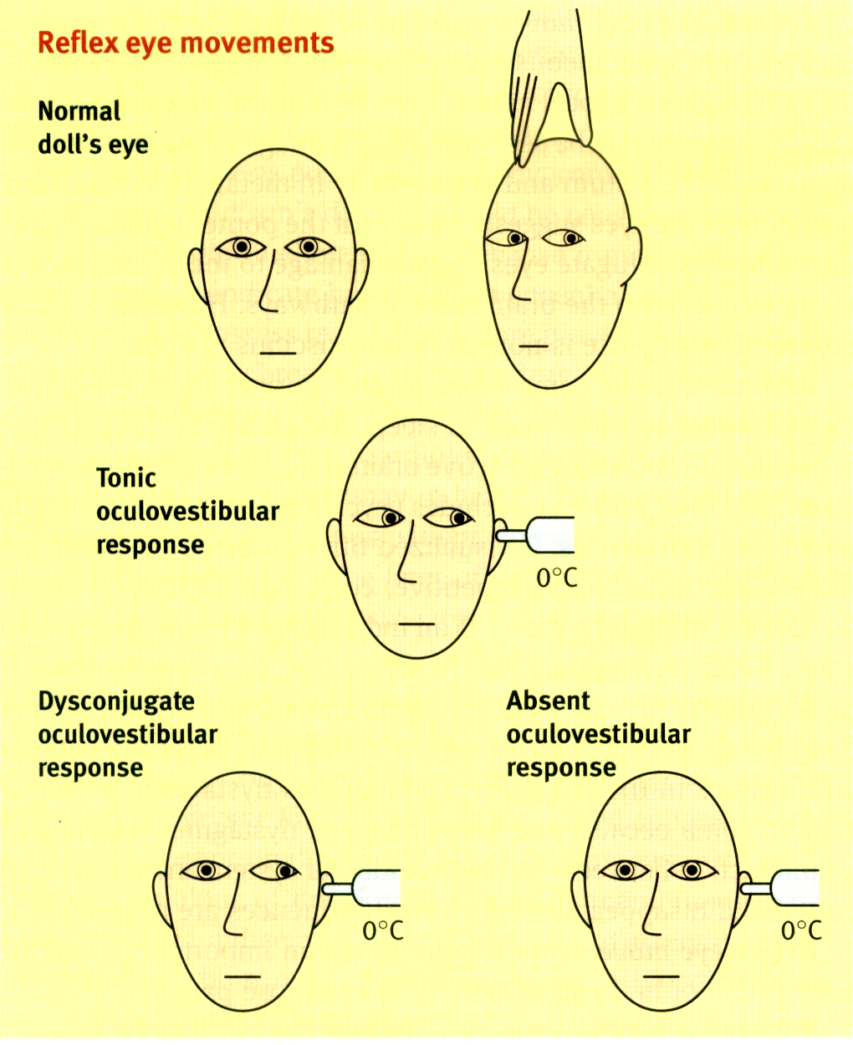
altered consciousness - assessment
oculo-cephalic reflex
(doll’s eye movements)

Slide 20
altered consciousness - assessment
absent in
  normal, conscious
  coma due to brain stem damage
present
  coma due to diffuse cortical dysfunction
oculo-cephalic reflex
(doll’s eye movements)

Slide 21
altered consciousness - assessment
vestibulo-ocular reflex (caloric testing)
normal
  tonic eye deviation towards ice water (cold calls)
  nystagmus away

Slide 22
altered consciousness - assessment
vestibulo-ocular reflex (caloric testing)
absent in brain stem damage

Slide 23
Unconscious Patient - Management

Slide 24
Unconscious Patient - Management
ABC, resuscitation
look for cause, treat cause, injuries
nursing care
  fluids, nutrition, feeding
  oral, eye, skin, bladder, bowel
physiotherapy - chest, limbs
prevent, treat complications
  pressure sores, infections, DVT, …

Slide 25
Unconscious Patient - Management
coma with focal deficits
  trauma, haemorrhage/ infarct
coma with meningeal irritation
  SAH, infection
coma with no focal deficits, no meningeal irritation
  metabolic, hypoxia, toxic, infection, …

